Slide 1
Final Project Proposal
Software Studio 軟體設計與實驗
Hung-Kuo Chu
Department of Computer Science
National Tsing Hua University
CS2410

Slide 2
Table of Contents
Final Project Introduction
Final Project Proposal
Reminders

Slide 3
Final project introduction

Slide 4
About the Final Project…
Make a web game with Cocos Creator.
Group assignment. 4~5 students per group.
Every group must submit their Final Project Proposal.
Make your slides (.ppt or .pptx), which should include the seven main sections. No restrictions on style, format, or number of pages, as long as your slides clearly express your game concept.

Slide 5
Why make a proposal?
It will help you figure out what your game’s about.
It will make you think about your game’s strengths and weaknesses, as well as possible difficulties in development.
It will be a rough blueprint for game design, gradually iterating to become a vision shared by all teammates.
You should know more about your game than the teacher and the TAs.

Slide 6
EXAMPLE TAIWANESE STUDENT

Slide 7
Final Project Proposal
Motivation (動機)
User Story (使用者故事)
Setting (遊戲背景故事) (Optional)
Controls (操作方式)
High Risk Analysis (高風險分析)
High Value Analysis (高價值分析)
Similar Games (市面上類似概念的遊戲)
Concept Art (模擬/假想畫面)

Slide 8
1. Motivation
What made your group want to make this game?
Could be a goal or a dream you want to achieve.

Slide 9
1. Motivation
We often get some information about summer internship. However, we thought that it was hard for us to get an offer just by the provided courses from NTHU.
Thus, we decided to make the thing come true in our game.

Slide 10
2. User Story
Narration with the player as the subject.
What will the player experience?
You can kill monsters, gain EXP, and level up in this game.
The player plays as a hero who can grow by gaining EXP from killing monsters.

Slide 11
2. User Story
The player plays as a NTHU CS student.
Through puzzle game (something like midterm or final) in the course, player can get the talent points to unlock new courses. Finally, player can choose a company and go for an interview.

Slide 12
3. Setting (Optional)
The background context of your game.
What kind of world will the player be thrown into?
This is not a writing contest, so don’t write too many pages here!
Try and keep it simple, with just the right amount of detail to get us interested.
Remember, even if you have an award-winning novel as your setting, if you can’t show it in your game, it’s worth nothing!

Slide 13
3. Setting (Optional)
Going through all kinds of difficulties, I become a NTHU CS student.
However, life goes on. What should I do for my future? What is the connection between course selection and prospects after graduation?

Slide 14
4. Controls
Cursor
Text here
Use mouse to select courses and finish the puzzle game.
Core Controls
Cursor
Keyboard
Keyboard
Player need to use keyboard during playing the puzzle game.

Slide 15
5. High Risk Analysis
High Risk: The core gameplay of the entire game. If you can’t implement it, the whole game becomes unplayable.
Some examples:
Super Mario Bros: Run and jump.
Angry Birds: Launch birds from a slingshot.

Slide 16
5. High Risk Analysis
Could also be fundamental requirements the game must satisfy to be fun at all.
Some examples:
Good controls for a platformer.
Interesting puzzle ideas for a puzzle game.
You can prioritize these items in development.

Slide 17
5. High Risk Analysis
Talent Table: The player has a talent table that records his/her current all kinds of talent points.
Courses: The player can get different kinds of talents point through different courses.
Puzzle Game: The player can get talent points by finishing the puzzle game.

Slide 18
5. High Risk Analysis
HP: The player need to spend HP selecting courses.
Curriculum: The player need to arrange his/her own curriculum.
Interview: The player go for an interview after finishing courses.

Slide 19
6. High Value Analysis
High Value: After completing core features, completing these features will make the game more special or enjoyable.
Examples:
Super Mario Bros: Power-ups, flagpole animation.
Angry Birds: Different bird types with different abilities.
Low priority features in game development.

Slide 20
6. High Value Analysis
Random Events: Add some random events such as romantic story, club activity, or part time job during taking courses.
Achievement System: There is a table that records the player achievement.
Animation: Add opening and closing animation.

Slide 21
7. Similar Games
Through observing other games, find out possible high-risk features and high value features, and figure out the core of the game genre.
Notes:
Note: If you are going to make software in general in the future (rather than just games), you can see this section as looking for similar products.

Slide 22
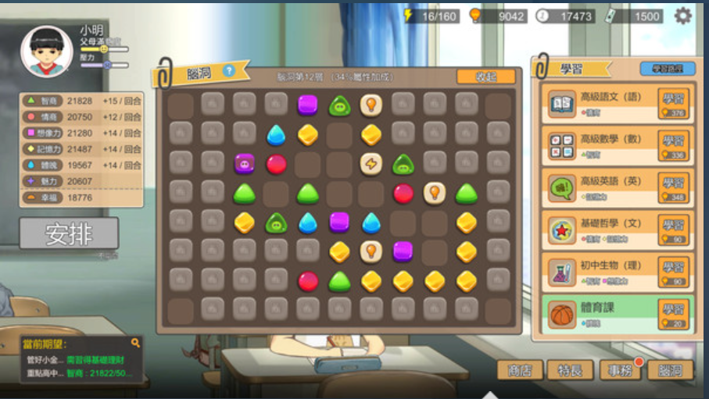
7. Similar Games
Chinese Parents

Slide 23
8. Concept Art
Everyone on a team might imagine the game differently, even with the same design document.
Some pictures can help bridge the gap between each person’s imagination.
You can:
Draw it yourself.
Simulate it by hand and record the footage.
Piece it together from images on the Internet.
Combine screenshots from existing games.

Slide 24
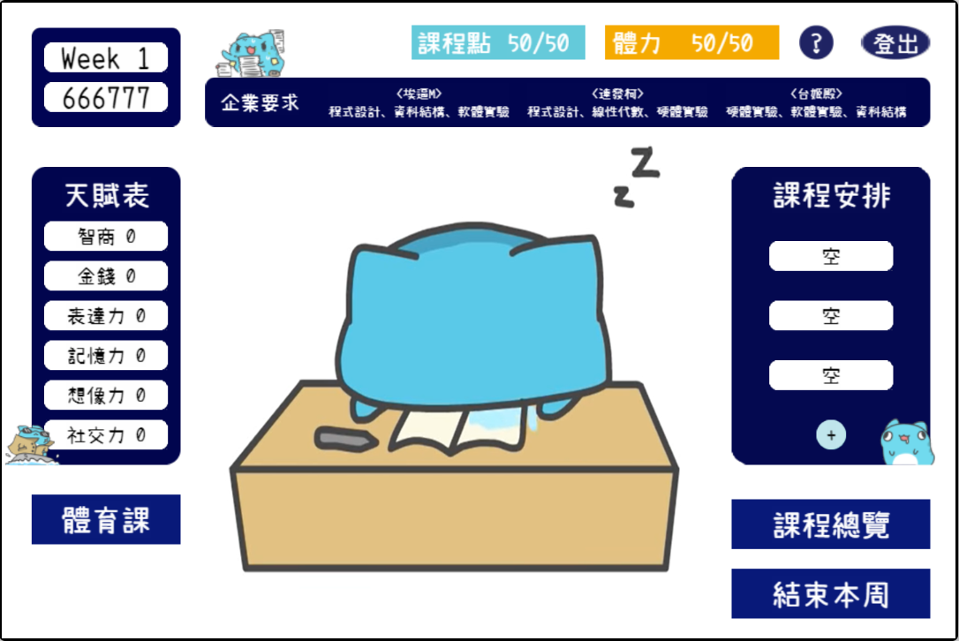
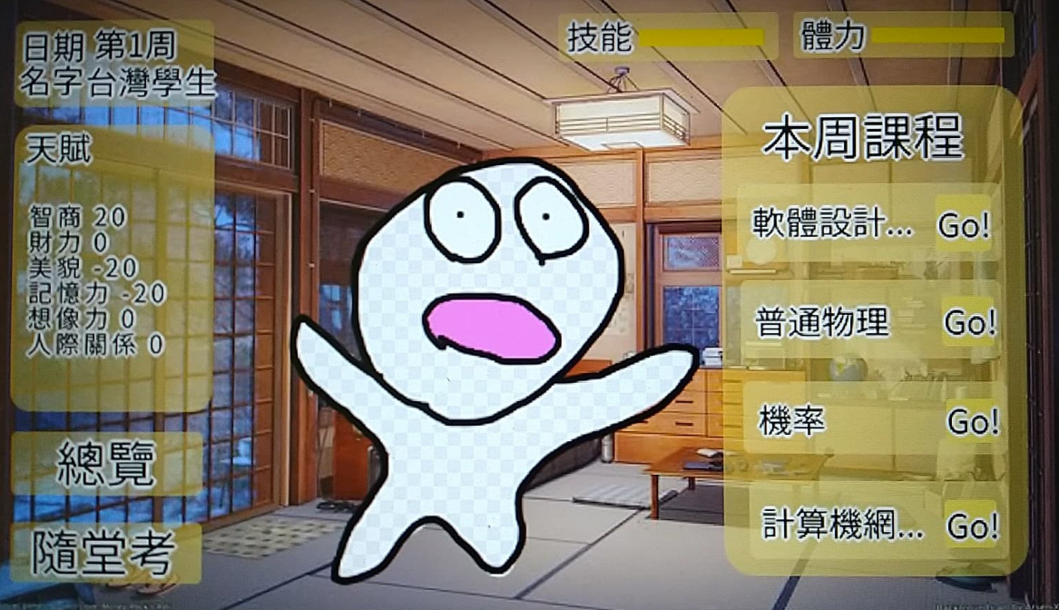
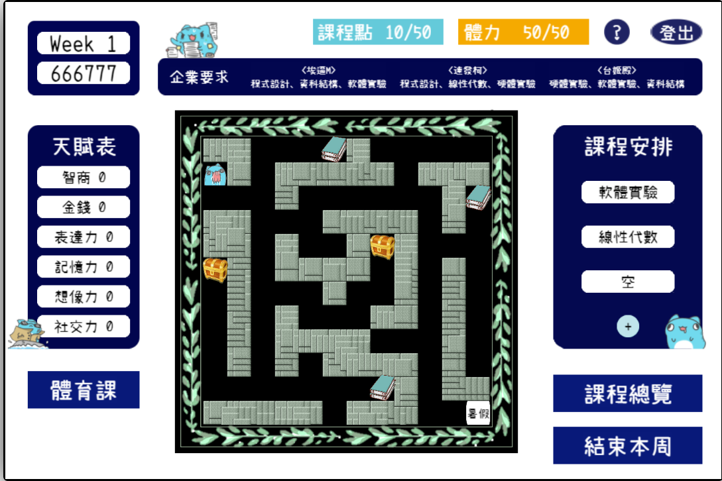
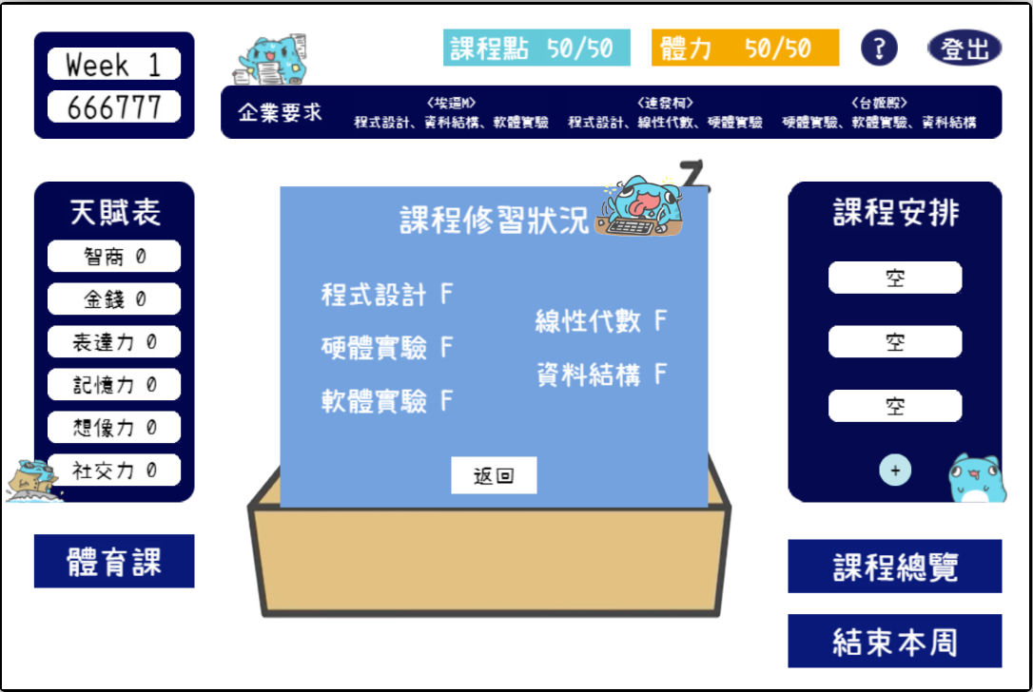
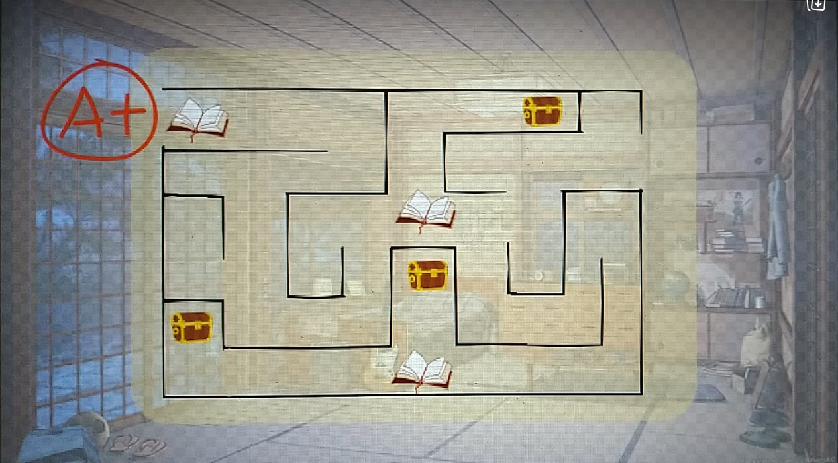
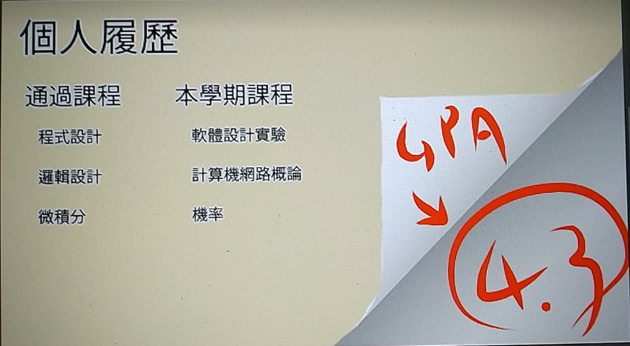
8. Concept Art

Slide 25
Reminders

Slide 26
Do not write these
Gameplay details
“In Angry Birds, the player can use blue birds after level 1-10, yellow birds after 1-16, black birds after 2-5, ...”
Mechanical details
“In Super Mario Bros, the player earns 50 points for breaking bricks, 200 for collecting a coin, 1000 for collecting a power-up, …

Slide 27
Abstract the details!
Gameplay details (abstracted)
“In Angry Birds, the player can use other birds with different abilities, unlocked as they progress through the game.”
Mechanical details (abstracted)
“In Super Mario Bros, the player earns score from doing actions such as breaking bricks and collecting coins and power-ups.

Slide 28
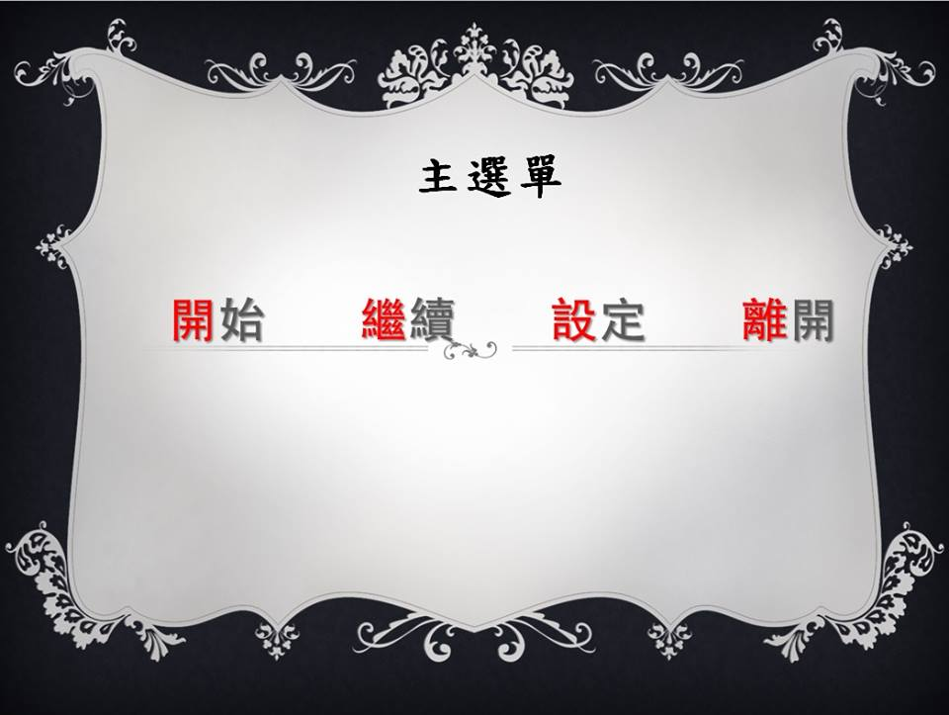
Do not write these

Slide 29
Remember…
This is a course about web programming, so we won’t teach everyone how to design award-winning web games.
You will be graded primarily on effort and technique, and less about how fun the game actually is.
It’s normal to have arguments in discussions!
A discussion where only one person has opinions is a failed discussion.
Enjoy the process, and you can make a game that you’ll be happy with!

Slide 30
Extra Resources
As everyone has different level of familiarity with 2D video games and software development, we will provide additional materials to help everyone make a game within about a month.
You can decide whether to check out these materials or not based on your own abilities.

Slide 31
Extra Resources
We provide extra materials such as:
An appendix on development.
Goes over version control with Cocos Creator, as well as programming techniques to reduce merge conflicts and allow more people to work at the same time.
An appendix on techniques.
Goes over various 2D game techniques that you can use in your final project.
A collection of resource sites for assets you can use in your game.

Slide 32
Schedule and Formats
Find your group before 4/28 (Tue) 23:59.
Submit your proposal before 5/5 (Tue) 23:59.
Upload to eeclass as group assignment. (5%)
You get a zero for late submission, but you must still submit even if you are late.
Filename: Group_xx_WebGame.pptx
Example: Group_02_WebGame.pptx
5/7 (Thu) Proposal Demo
6/13 (Sat) or 6/14 (Sun) Final Project Demo (tentative date)

Slide 33





